Slide 1
Week 9, Lecture 1
Files

Slide 2
This week’s topics
Files concepts (Chapter 13: sec. 1, Tutorial: File I/O)
File handling classes (Chapter 13: sec. 2-4, Tutorial: File I/O)
Stream handling classes (Chapter 13: sec. 3-4, Tutorial: I/O streams)
Random access files (Chapter 13: sec. 6-7, Tutorial: File I/O)
Reading material:
Chapter 13 of the textbook (a bit disorganised)
Java tutorial on I/O
https://docs.oracle.com/javase/tutorial/essential/io/index.html

Slide 3
File concepts

Slide 4
Files
Files are collections of data that exist on secondary storage.
Secondary storage
Larger (256 Gigabytes on this laptop)
Slower, but better for sequential access
Non-volatile (stays when powered off)
All this contrasts with the main memory (or primary storage)
Smaller (16 Gigabytes on this laptop)
Faster (about 1-100 cycles of 2.6 Gigahertz clock)
Volatile (disappears when powered off)
The main memory is accessed by “random access”
Specify an address, receive data (or write data)
The secondary storage is often accessed by sequential access (but not always)
Find a file location, then read all of it (or write all of it) one piece at a time

Slide 5
File folders
On a Windows PC, you generally find:
“C:” (refers to the main disk drive)
Users
User-name
Courses
Java
Temp
Teaching
Java
Path names
E.g. “C:\Temp\Teaching\Java\data.txt”
If you use a Unix-style file system, use forward-slash (/) instead of back-slash (\)
Relative path – Path relative to the current directory
E.g., If the current directory is “C:\Temp\Teaching” then “Java\data.txt” is a relative path.
Absolute path – is the full path (i.e., non-relative path)

Slide 6
Working with files
Access a file using a file path.
Open the file (either for reading or for writing, may be automatic)
Read/write
Text files (contain characters – Java’s Unicode or ASCII for English)
Binary files (other kinds of data)
Do this using I/O streams
Close the file.
Handle IOExceptions.
There are also other file operations
Delete file
Rename file
Move file within the file system

Slide 7
File handling classes

Slide 8
Java classes for File I/O
We will use two packages:
import java.io.*;
import java.nio.file.*; // nio stands for “new I/O”, added in Java 1.7
The classes you will need to use:
FileSystem – a bureaucratic class needed for the top level (but we can suppress it)
Path – class for file paths, as well as files themselves!
Paths (note the plural) – utility functions for paths
Files (note the plural) – file operations on paths, i.e., files
Is there a File class (without the plural)?
There is, but the Path class from the nio package can do all of its work.

Slide 9
Working with paths
Operations on paths
Creating paths
Extracting components of paths
Extracting subpaths
Comparing paths (check if one is a subpath of another)
Converting relative paths to absolute paths

Slide 10
Sample code for paths
import java.nio.file.*;
public class FileTest {
public static void main(String[] args) {
String pathString = “C:\\Temp\\teaching\\Java\\data.txt”;
Path myPath = Paths.get(pathString); // make it into a Path object
Path easyPath = Paths.get(“C:\\Temp”, “teaching”, “Java”, “data.txt”);
// Decomposing the path
int count = myPath.getNameCount();
for (int i=0; i < count; i++)
System.out.println(myPath.getName(i));
// This should print Temp, teaching, Java and data.txt on separate lines.
Path directory = myPath.subpath(0, count-1);
System.out.println(directory); // That prints \Temp\teaching\Java
}
}

Slide 11
Working with files
Operations on files
Checking if a file exists and is readable/writable
Opening file (before you actually do any I/O, usually automatic)
Closing file (after you finish the I/O)
Sequential access (read/write the data in sequence)
Random access (read/write arbitrary elements in the file)

Slide 12
Working with files
Checking if a file exists
Files.exists(path-object)
Files.isReadable(path-object)
Files.isWritabe(path-object)
Character files – sequential access
Use Reader/Writer, BufferedReader/BufferedWriter classes
The “Buffered” versions are used just for efficiency
Flushing the output buffer may be necessary before closing it.
Binary files – sequential access
Use InputStream/OutputStream and other related classes
Opening/closing files can be usually done automatically, but not always.

Slide 13
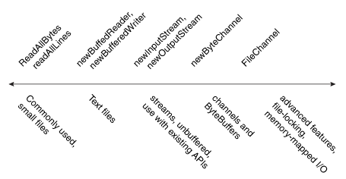
Many ways of working with files (Java tutorial)
1
2

Slide 14
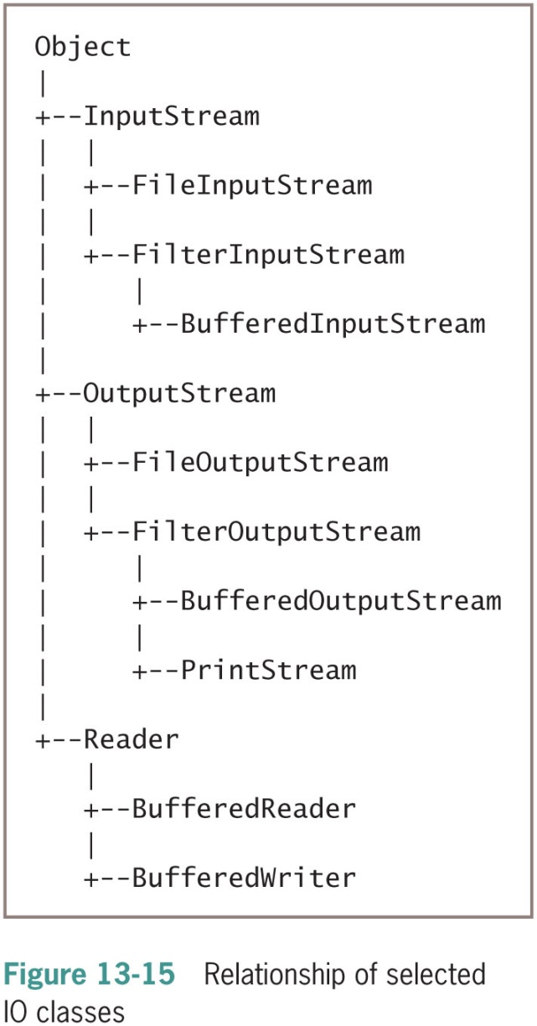
Many ways of working with files (textbook)
You have already seen examples of these:
System.in, System.out
There should be a Writer class here

Slide 15
Try-with-resources (exceptions and resources)
Almost all I/O operations throw IOException or its subclasses.
They are checked exceptions, subject to “catch-or-declare” requirement.
Good idea to use the try-with-resources statement:
try (Resource r1 = … ; // These will be automatically closed at the end
Resource r2 = … ;
)
{… … Code with I/O operations
}
catch (IOException e) {
System.err.println(“Something went wrong”);
e.printStackTrace(System.err);
}

Slide 16
Or, standard try block (exceptions only)
Closing needs to be done separately in a finally clause:
Resource r1 = … ; // These will not be closed automatically
Resource r2 = … ;
try {… … Code with I/O operations
}
catch (IOException e) {
System.err.println(“Something went wrong”);
e.printStackTrace(System.err);
}
finally { // Flushing may also be needed
r1.close();
r2.close();
}

Slide 17
Sample code (read names, sort and write)
try (Scanner scanner = new Scanner(readPath);
BufferedWriter writer = Files.newBufferedWriter(writePath);
)
{
Name[] names = new Name[100];
int nameCount = 0;
while (scanner.hasNext()) {
String firstName = scanner.next();
String lastName = scanner.next();
names[nameCount++] = new Name(firstName, lastName);
}
Arrays.sort(names, 0, nameCount);
for (int i=0; i < nameCount; i++) {
String name = names[i].toString();
writer.write(name, 0, name.length());
writer.newLine();
}
}
catch (IOException e) { … }

Slide 18
Summary
Files exist on secondary storage (larger, slower, non-volatile)
Files are organised into directory hierarchies (or folder hierarchies)
Files are accessed by paths, which are handled in Path and Paths classes.
Reading and writing of files can be done at many levels of abstraction.
Text files using Reader/Writer classes
Buffering is used for efficiency, may need flushing.
Try-with-resources statement allows automatic closing of resources.

